Slide 1
Front End Engineering-I Project
Team Details:
Khushboo - 2410993045
Ishleen Kaur - 2410993197
Faculty Coordinator:
Dr. Chetna Sharma
:
Chitkara University Institute of Engineering and Technology,
Chitkara University, Punjab

Slide 2
Table of Contents
Introduction
Problem Statement
Technical Details
Key Features
Project Highlights
Bonus Feature(optional)
Conclusion
References/Links used

Slide 3
Introduction
JAVASCRIPT QUIZ GAME
TEAM MEMBERS :-
Khushboo (Leader) - 2410993045
Ishleen Kaur - 2410993197
Goal :- Quizzes can be used as a brief assessment in education to measure growth in knowledge, abilities, and skills.

Slide 4
Problem Statement
Aim :- The aim of this is to improve knowledge retention and briefly test a student’s level of comprehension regarding course.
It also helps in the cognitive development as it enhances memory, problem solving skills, and critical thinking.
Some research for this project is done from various web development tutoring sites and channels.

Slide 5
Technical Details
HTML(HyperText Markup Language) for the basic structure (used as building block) of the game
CSS(Cascading Style Sheet) for the designing and beautification of the game.
JS(JavaScript) for making the game working and fully functional.

Slide 6
Key Features
User-friendly interface:-
Intuitive design for cognitive development through various kinds of questions related to the course.
Gamified Learning Experience:-
Motivates students to actively participate in education.
Analytical Abilities:-
Helps students gather, organise questions
Quantitative Reasoning:-
Skills to analyze and interpret vast variety of questionarrie related to the course

Slide 7
Project Highlights
Upcoming slides include the relevant screenshots of our running project and their corresponding code snippets.

Slide 8
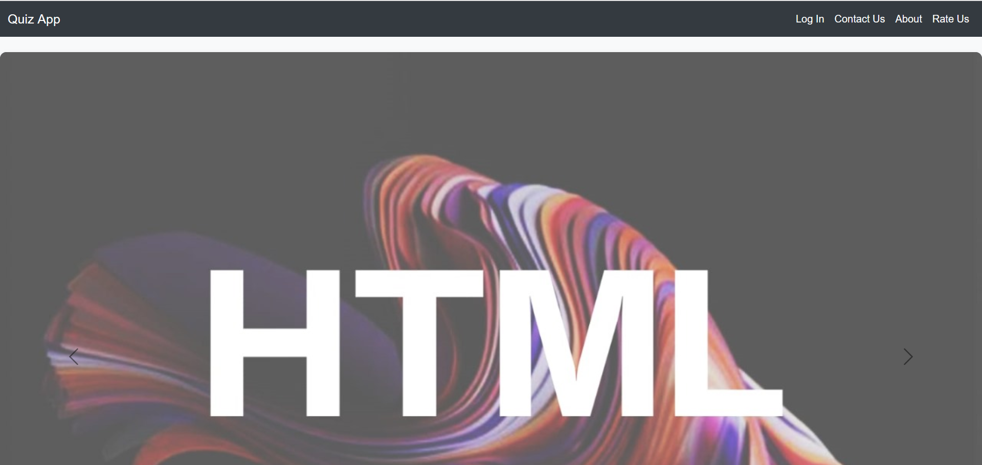

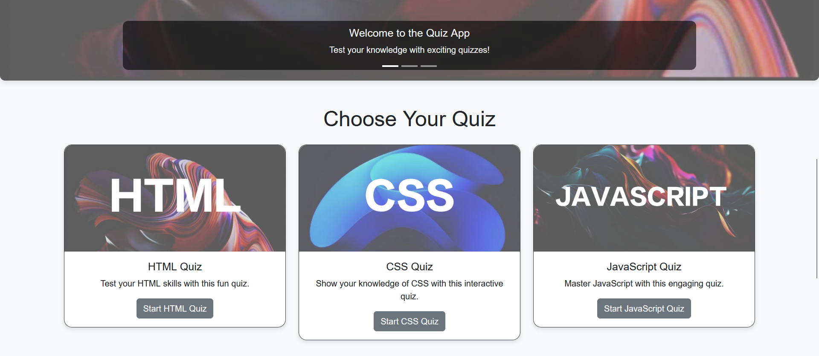
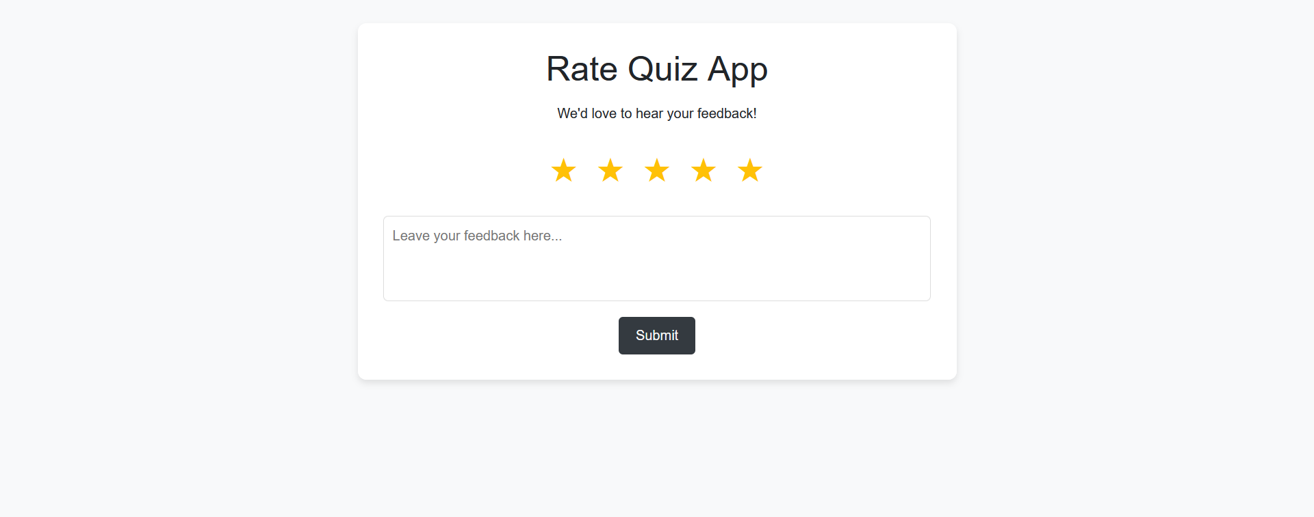
Project Highlights

Slide 9
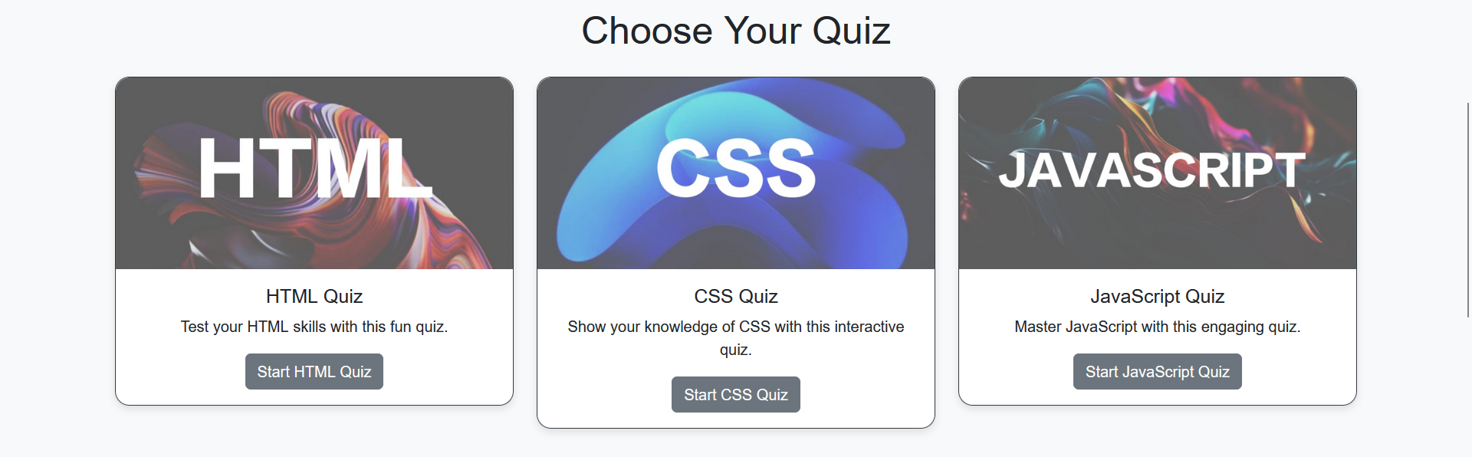
Project Highlights

Slide 10
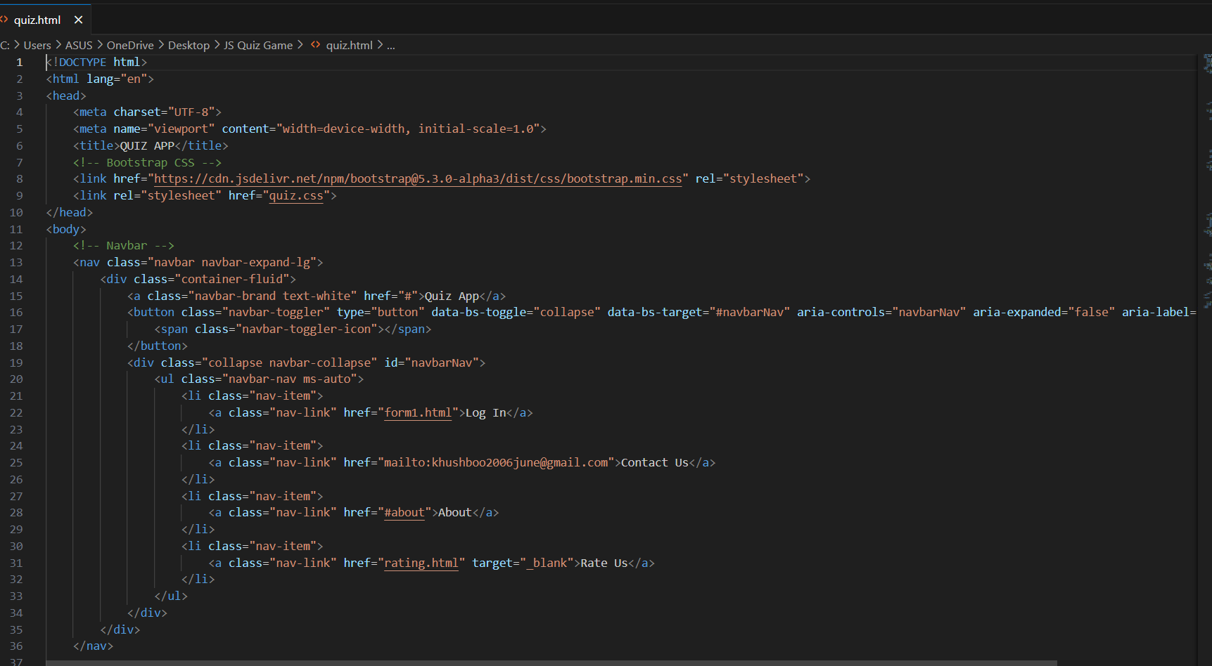
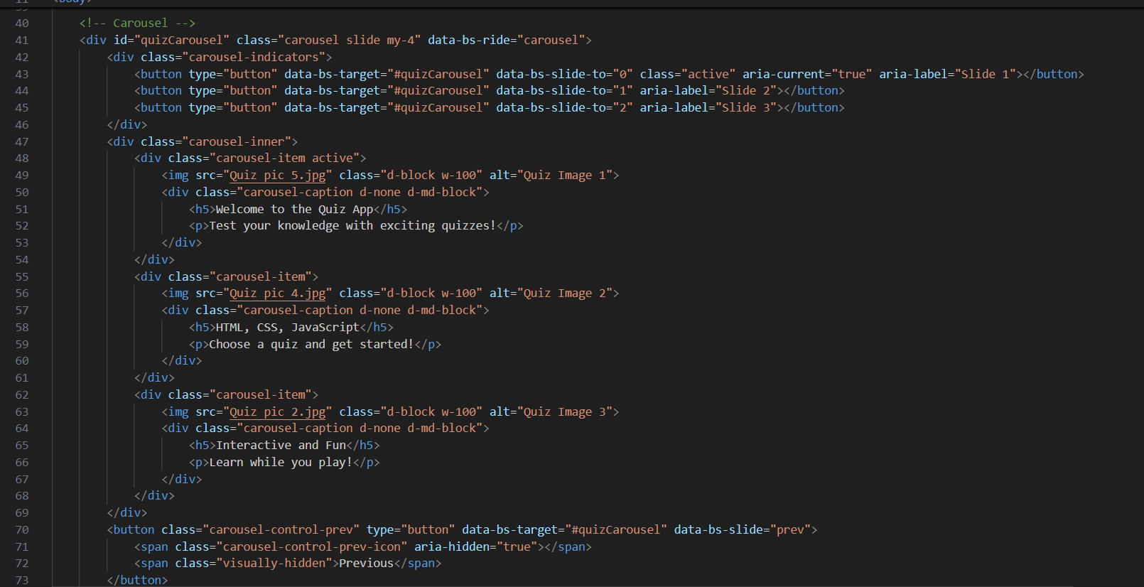
Project Highlights

Slide 11
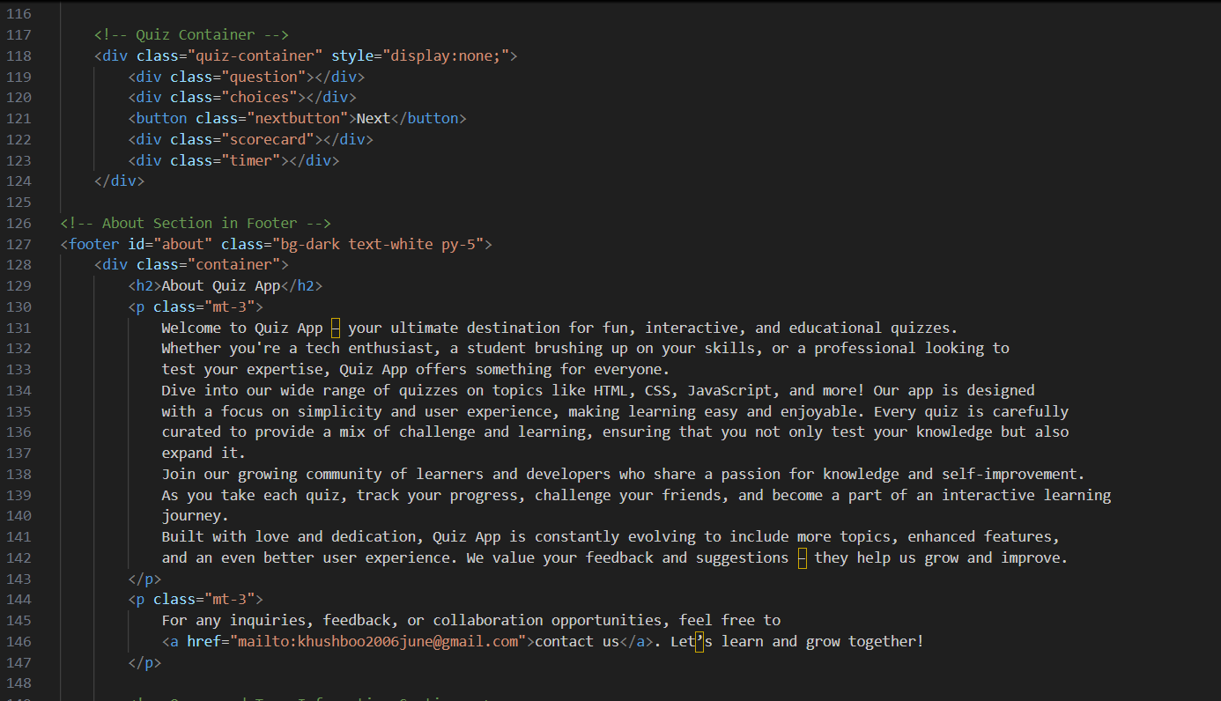
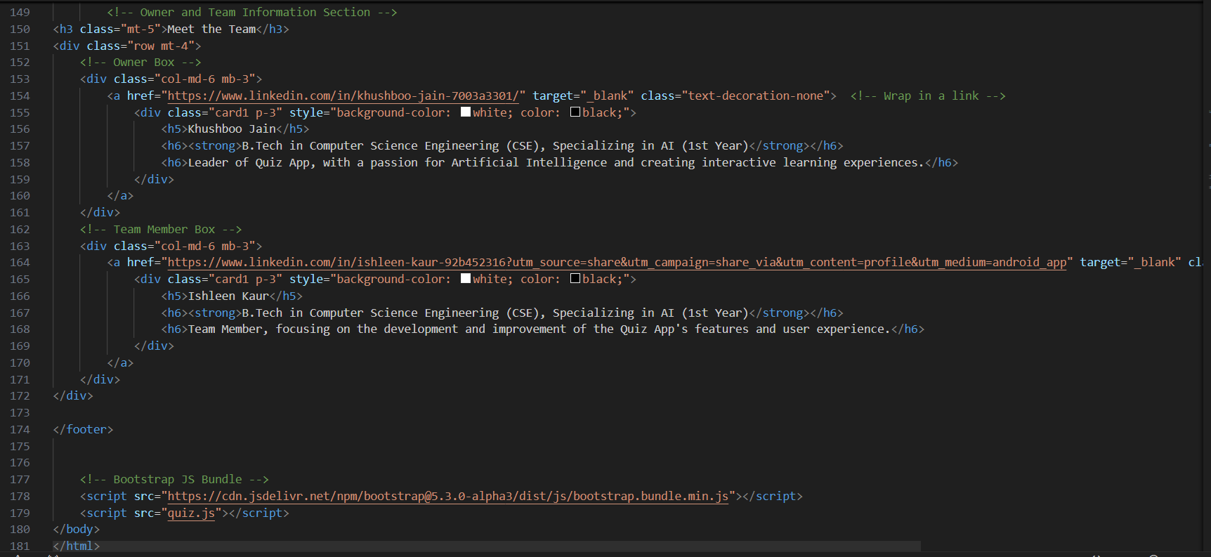
Project Highlights

Slide 12
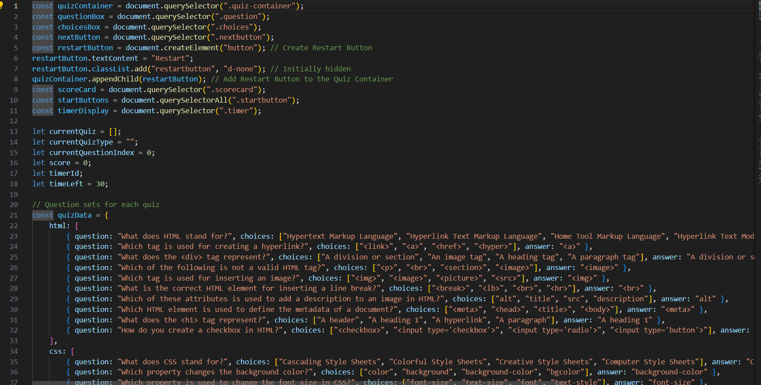
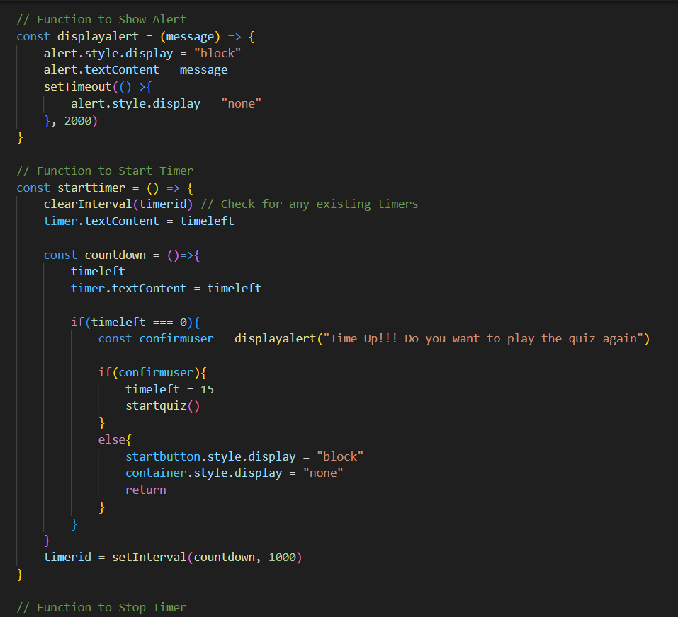
Project Highlights

Slide 13
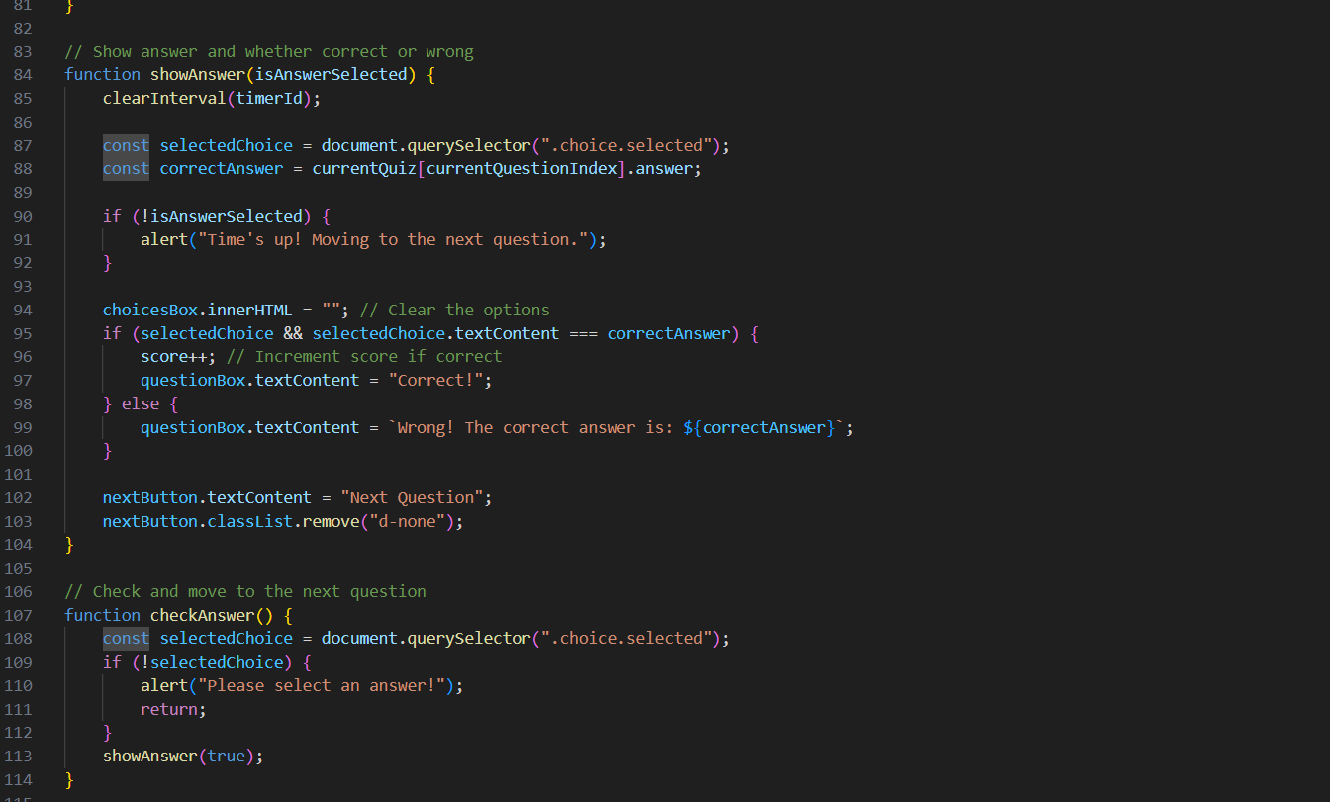
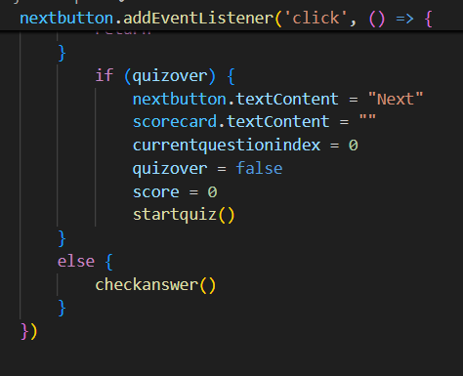
Project Highlights

Slide 14
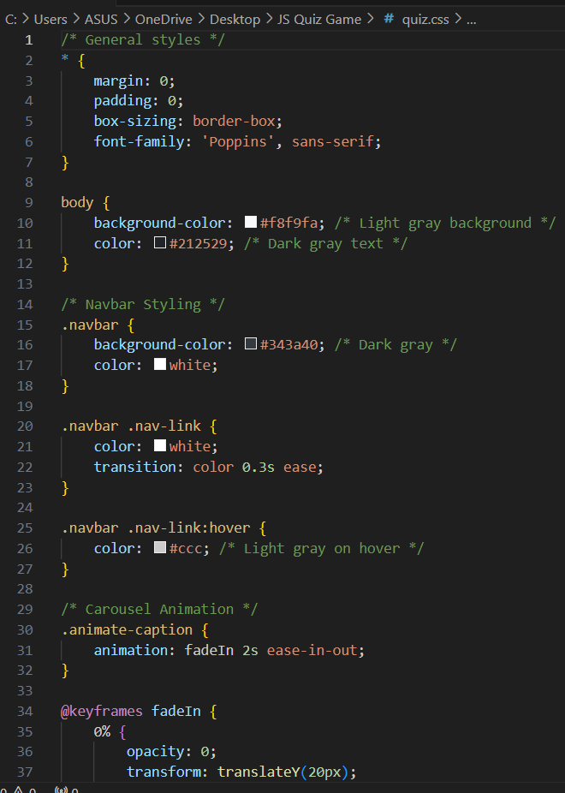
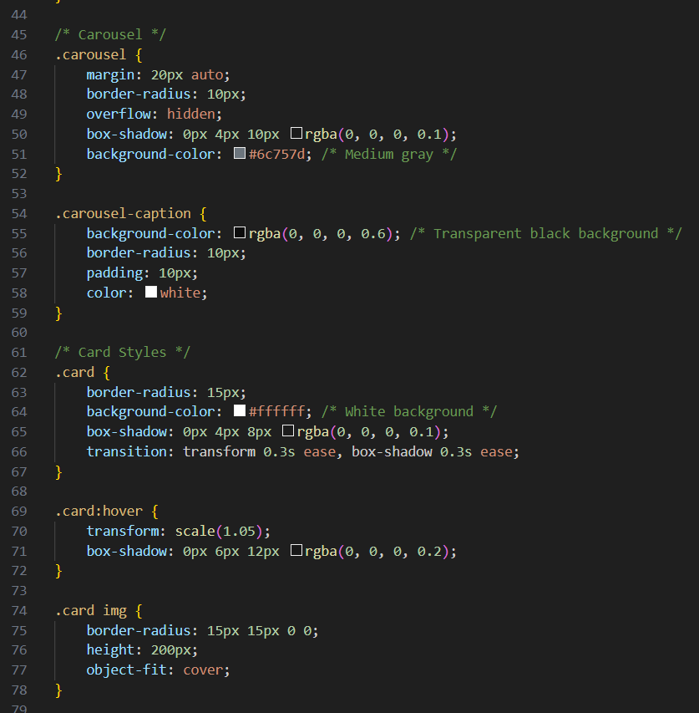
Project Highlights

Slide 15
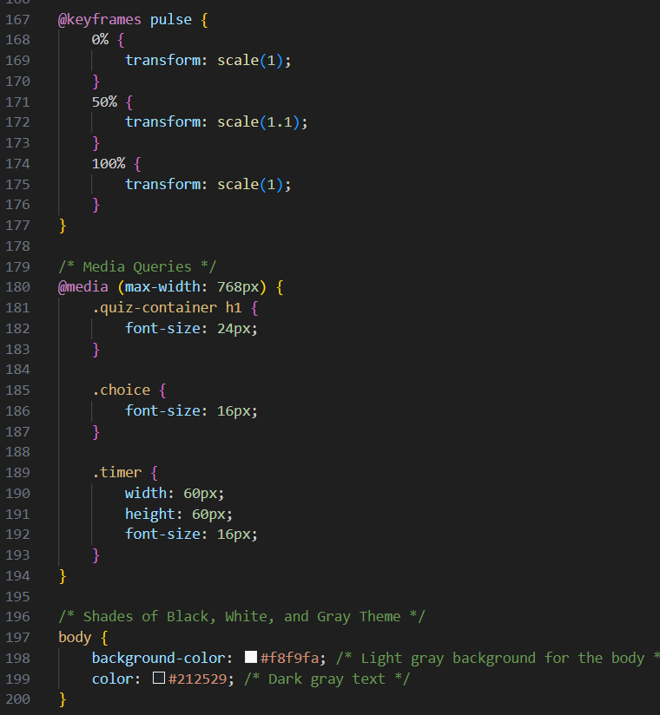
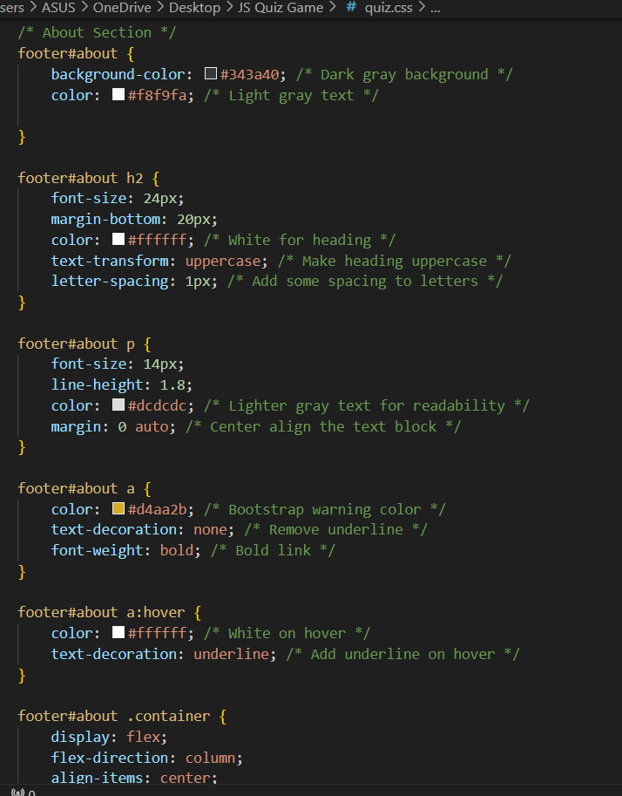
Project Highlights

Slide 16
Bonus Feature(optional)
The next slide highlights the specific TIMER feature that is a bit distinct and innovative in your project.

Slide 17
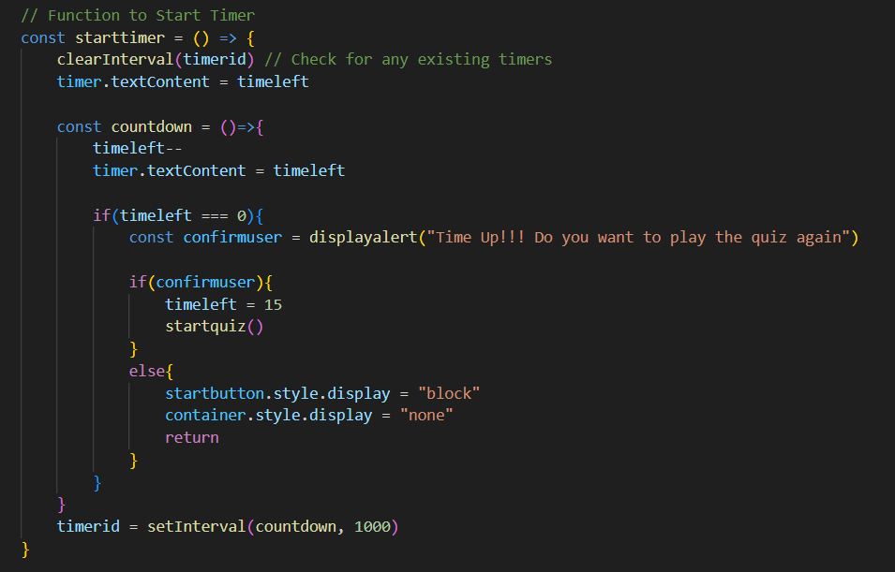

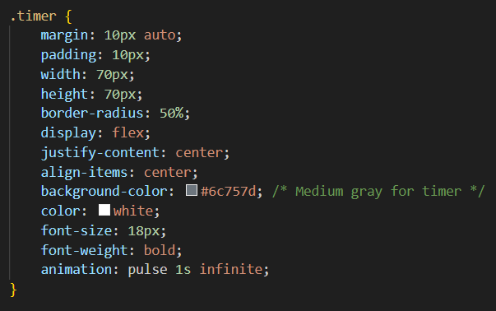
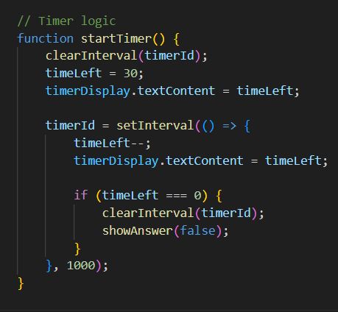

Slide 18
Conclusion
Following are the conclusions that can be aroused by the benefits of building this JavaScript enabled quiz game
1. Cognitive Development: Enhances memory, problem-solving skills, and critical thinking. 2. Educational Benefits: Aids in learning basics in various subjects, expands vocabulary, and helps in understanding complex concepts through simple explanations. 3. Social Skills: Encourages interaction with friends and family. 4. Speed: Develops the agility to quickly understand the question and reflect back faster. 5. Creativity: Stimulates imagination and creative storytelling, especially in riddle and puzzle solving. 6. Attention and Concentration: Helps in focusing attention and improves concentration through engaging gameplay. 7. Screen free time: Engages in real world, without screen..

Slide 19
References/Links used
References used in the project are:-
Sir Pavan Ambulkar’s provided course notes
W3Schools website
Several YouTube channels like:-
CodeWithHarry
ApnaCollege

Slide 20


